Slide 1

Bank Marketing (Campaign)
Name: Mustafa Fakhra
Location : Dubai, UAE
Project: Data Science
Date : 24-September-2022

Slide 2
Executive Summary
Problem Statement:
ABC Bank wants to sell it's term deposit product to customers and before launching the product they want to develop a model which help them in understanding whether a particular customer will buy their product or not (based on customer's past interaction with bank or other Financial Institution).
ML Problem:
With an objective to gather insights on the factors that are impacting the persistency, build a classification for the given dataset.
The highest model accuracy and precision were attained using the Random Forest model.

Slide 3
Project Steps
Understanding the case
Importing Required libraries and dataset
Understanding our data (data exploratory)
Data processing and transformation
Model Building
Model evaluation
Model Deployment

Slide 4
Data Processing
File Used: bank-additional-full.csv
Correlation between all variables and the predictor.
Missing data or nulls exist and have been handled.
Data wrangling transformation included normalizing data and standardize them.
This has increased the correlation between the features and the predictor variable.
Dummy variables have been created (Categorical variables to 0 and 1).

Slide 5
Model Building
The case is classification so we will be using three models:
Logistic Regression, Ridge Regression, & Random Forest classifier.

Slide 6
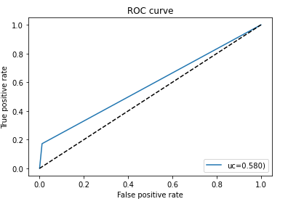
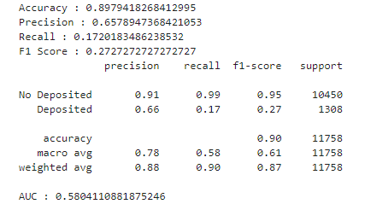
Logistic Regression Model Results

Slide 7
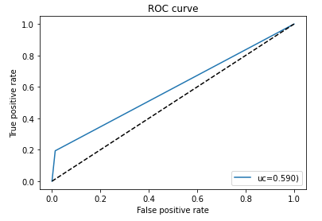
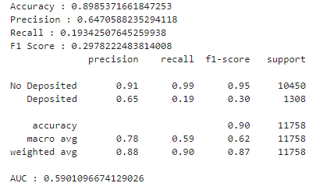
Ridge Regression Model Results

Slide 8
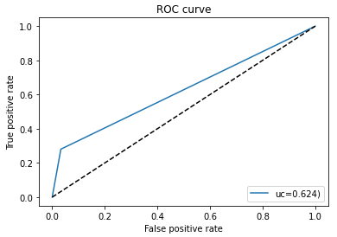
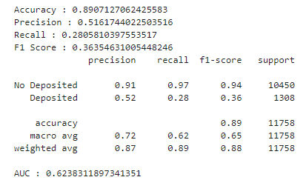
Random Forest Model Results

Slide 9
Random Forest Model
Model Trade-offs:
Advantages:
Insensitive to Outliers.
Insensitive to Null values.
Less Prone to overfitting.
Disadvantages:
Losing Interpretability.
Difficult to diagnose and improve.
Results obtained:
Accuracy: 87 – 89 %

Slide 10
Conclusion
Approximately all the classifiers have same result, but Random Forest was the best one.
The model has around 89% Accuracy.
Random Forest has 87% Precision, 89% Recall, & 88% F1 Score.
We can also see the results for each classifier as well.

Slide 11
Thank You

